Slide 1
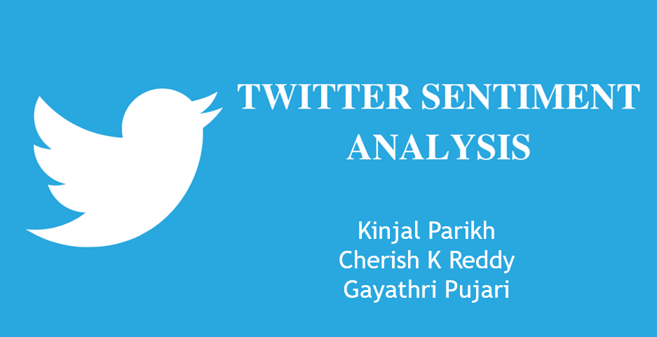
PRESENTATION BY

Slide 2
AGENDA
Sentiment Analysis And Its Importance
Why Twitter Data for Sentiment Analysis
Challenges
Process Flow
Case Study 1: Fetch The Twitter Data
Case Study 2: Analyzing The Sentiment Data, Implementing The Model, Prediction, Confusion Matrix And Finding The Accuracy Of The Data
Recommendation
Conclusion

Slide 3
Sentiment Analysis & Its Importance
Process of determining whether a piece of writing is positive, negative or neutral.
Public opinions on service review is positive or negative.
Public opinions on whether the customer is satisfied or dissatisfied.
Based on sample of tweets, how are people responding to any
ad campaign/product release/Service/news item.
How the Bloggers attitudes about a particular topic changes?

Slide 4
Why Twitter Data for Sentiment Analysis?
250+ million active users.
500 million tweets are generated daily.
Variety of twitter audiences.
Tweets are short in length of 140 characters.
User shares personal views on various subjects.

Slide 5
Challenges
People expression opinions in complex ways.
Unstructured and also non-grammatical.
Lexical variations and out of Vocabulary words.
Rhetorical devices/moods such as sarcasm, irony, implication etc.
Extensive usage of acronyms like asap, lol etc.

Slide 6
Process Flow
Getting keys and tokens
Authorizing using tweepy
User search query
Cleaning tweets
CASE STUDY 1
Exporting to CSV file
Calculating sentiment with polarity
Creating dataframe
CASE STUDY 2
Implementing the model
Predicting the model
Finding Accuracy
Conclusion

Slide 7
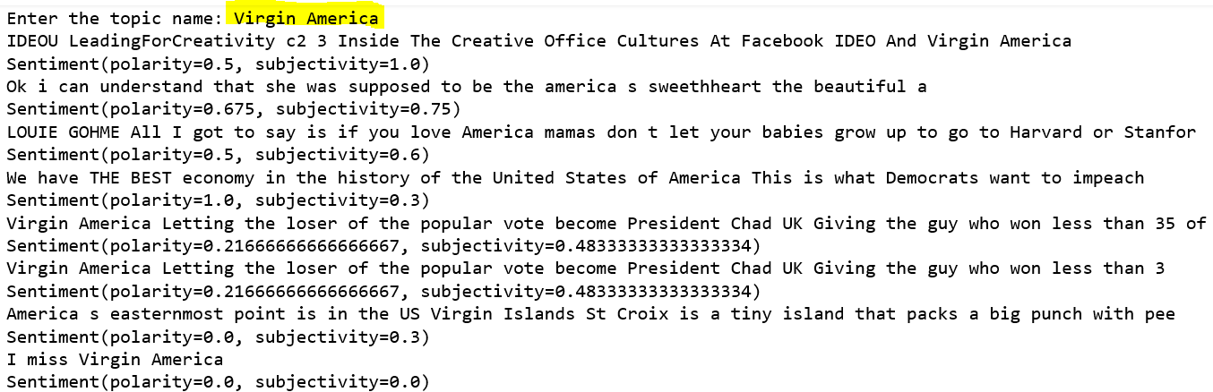
Case Study 1: Fetch The Twitter Data
1) Connect to Twitter API by requesting for the access tokens consumer_key, consumer_secret, access_token_key, access_token_secret keys.
2) Take the input of the user search query and gather tweets matching a particular keyword/hashtag/mention.

Slide 8
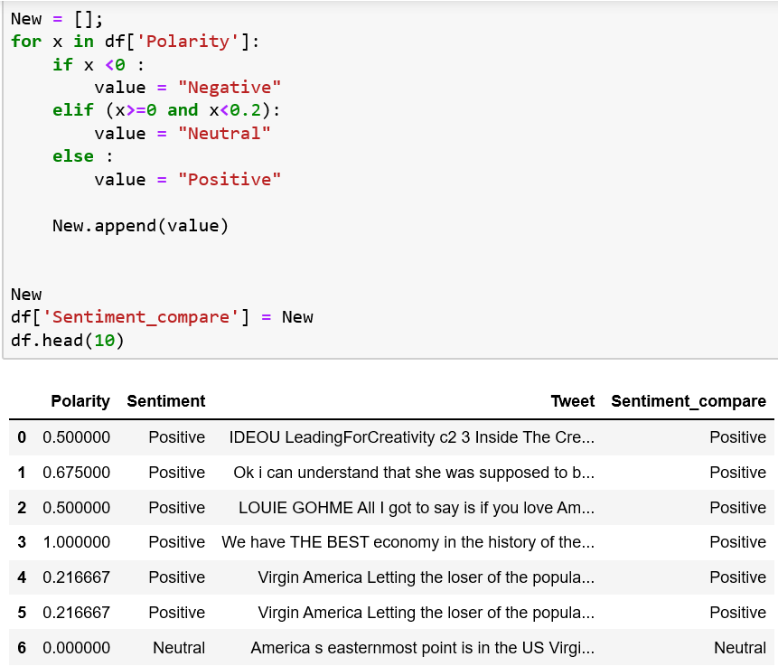
Case Study 1: Fetch The Twitter Data
3) Clean the fetched tweets.
4) Creating a data frame having the column names as Polarity, Sentiment, Tweet.
5) Calculating the polarity of tweets having the sentiments as positive, negative and neutral.

Slide 9
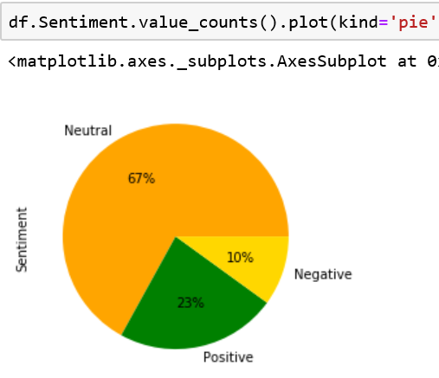
Case Study 1: Fetch The Twitter Data
5) Plotting the percentage count for the sentiments as positive, negative and neutral.

Slide 10
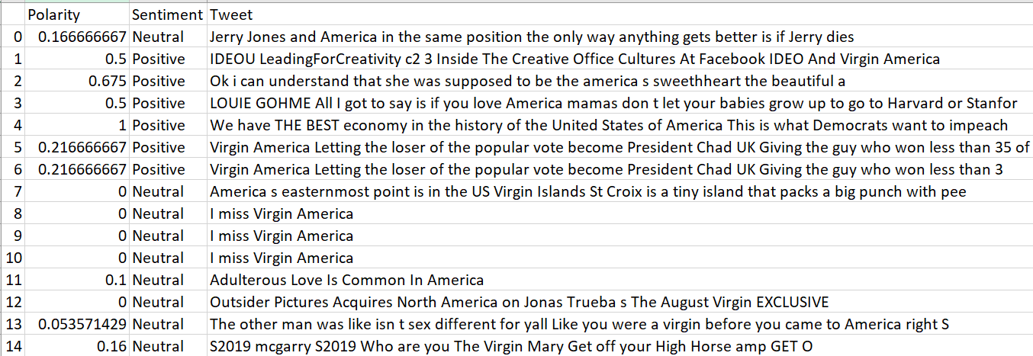
Case Study 1: Fetch The Twitter Data
6) Generating a csv file for tweets and its sentiments.

Slide 11
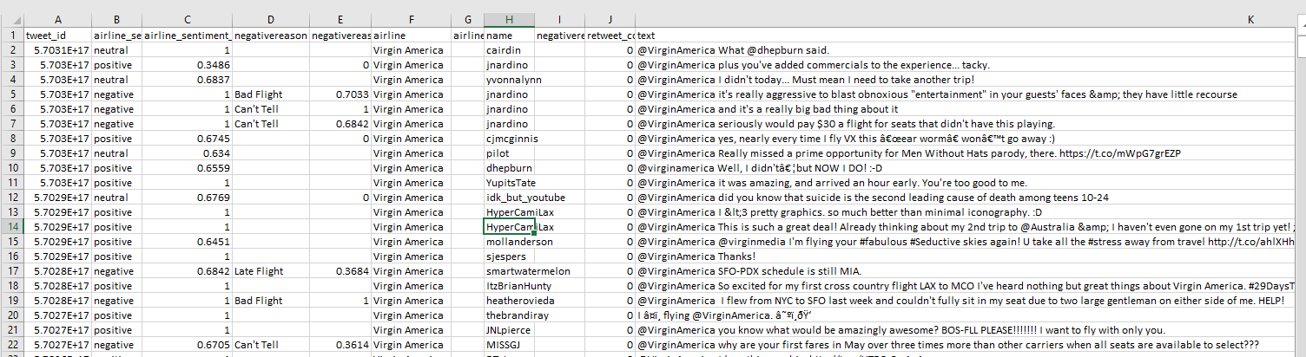
Case Study 2: Analyzing the Sentiment data, Implementing the model, Prediction, Confusion Matrix and Finding the accuracy of the data
Steps Performed:
1) Fetch the tweets data from the csv file.

Slide 12
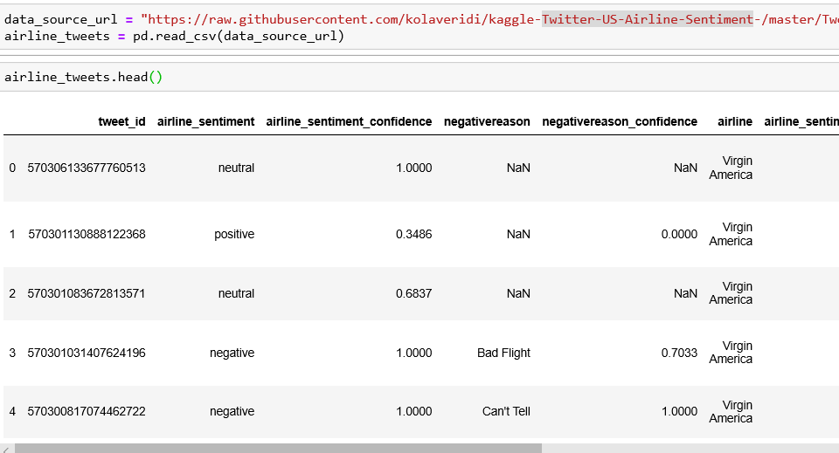
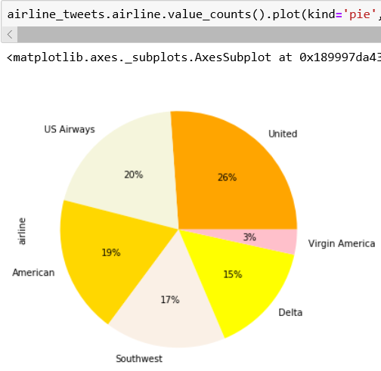
Case Study 2: Analyzing the Sentiment data, Implementing the model, Prediction, Confusion Matrix and Finding the accuracy of the data
2) Creating a Data Frame
3) Counting the number of tweets percentage for the six US_Airlines.

Slide 13
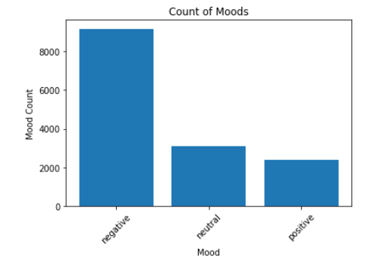
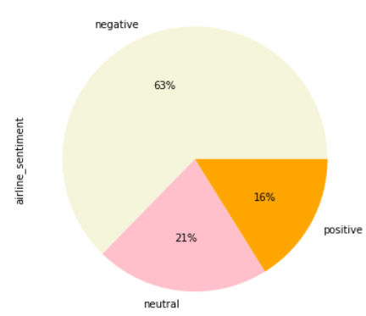
Case Study 2: Analyzing the Sentiment data, Implementing the model, Prediction, Confusion Matrix and Finding the accuracy of the data
4) Calculating the Percentage of count for the tweet_sentiments.
5) Calculating the mood counts.

Slide 14
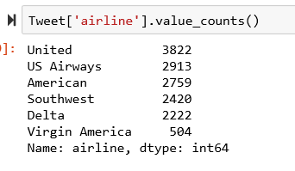
Case Study 2: Analyzing the Sentiment data, Implementing the model, Prediction, Confusion Matrix and Finding the accuracy of the data
6) Segmenting the tweet_count for all the six airlines.
7) Cleaning the tweet_text
Deleting specific columns.
Removing all the special characters.
Removing all the single characters.
Remove single characters from the start
Substituting multiple spaces with single space
Removing prefixed 'b’
Converting to Lowercase

Slide 15
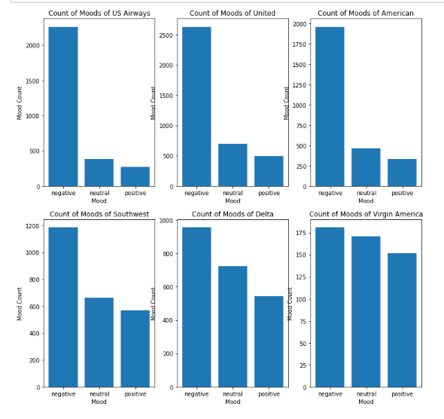
Case Study 2: Analyzing the Sentiment data, Implementing the model, Prediction, Confusion Matrix and Finding the accuracy of the data
8) From the plots one can find that the distribution of moods for the first three airlines are always skewed toward negative moods. On contrary, the moods are distributed more balanced with the later three airline companies.

Slide 16
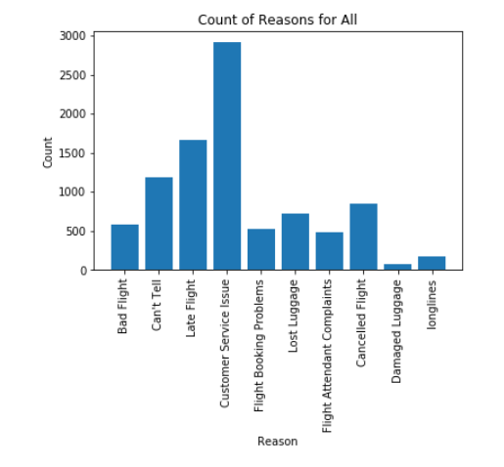
Case Study 2: Analyzing the Sentiment data, Implementing the model, Prediction, Confusion Matrix and Finding the accuracy of the data
9)Count of reasons for all the airlines.

Slide 17
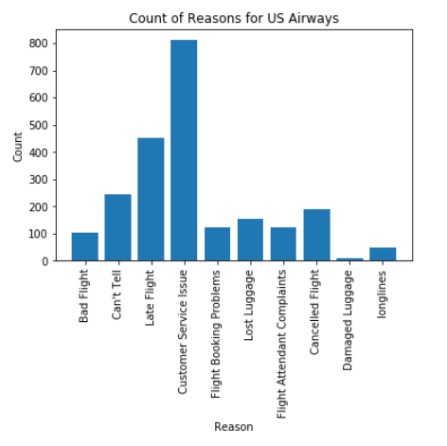
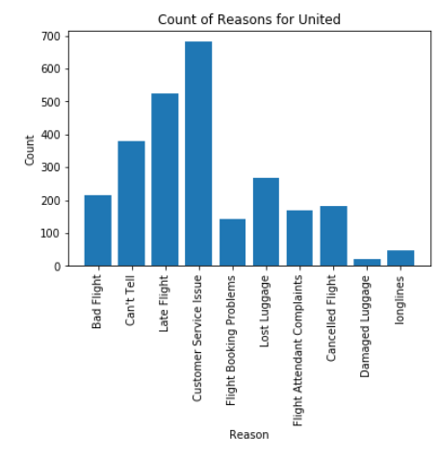
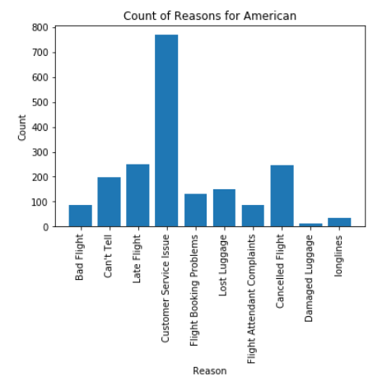
Case Study 2: Analyzing the Sentiment data, Implementing the model, Prediction, Confusion Matrix and Finding the accuracy of the data

Slide 18
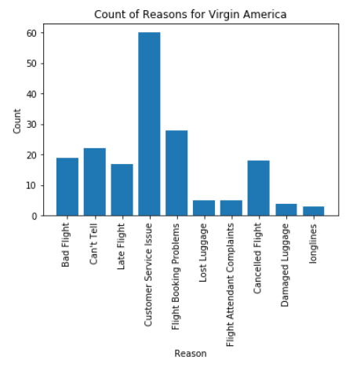
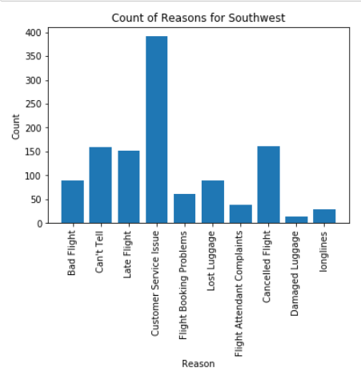
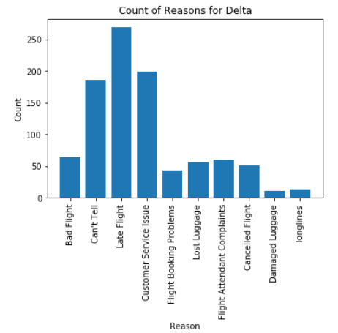
Case Study 2: Analyzing the Sentiment data, Implementing the model, Prediction, Confusion Matrix and Finding the accuracy of the data

Slide 19
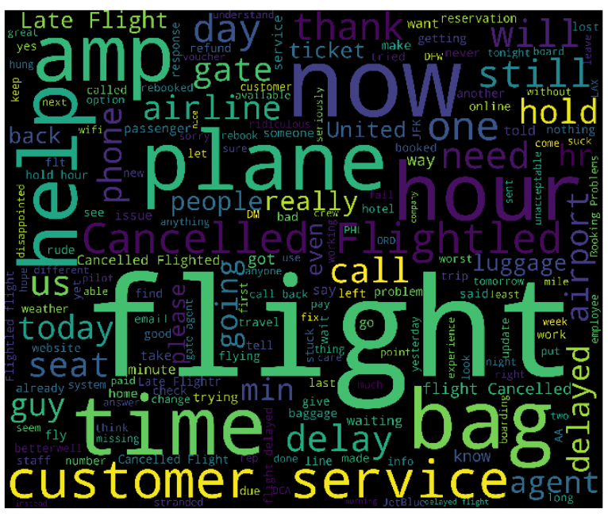
Case Study 2: Analyzing the Sentiment data, Implementing the model, Prediction, Confusion Matrix and Finding the accuracy of the data
10) We can find that the Tweets with negative moods are frequently involved some words like cancelled, late flight ,customer or service. People might guess that customer tends to complain when they are waiting for the delayed flights

Slide 20
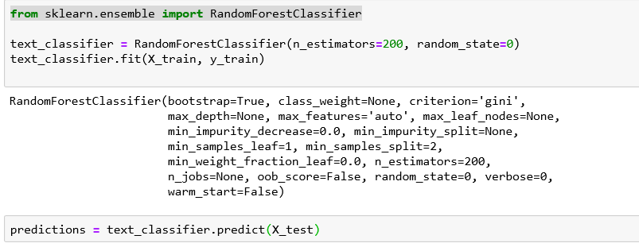
Case Study 2: Analyzing the Sentiment data, Implementing the model, Prediction, Confusion Matrix and Finding the accuracy of the data
11) Implementation of Model
Dividing our data into training and testing sets
We will use the 80% dataset for training and 20% dataset for testing.
Using the Random Forest algorithm, owing to its ability to act upon non-normalized data.
12) Making Predictions on the Model

Slide 21
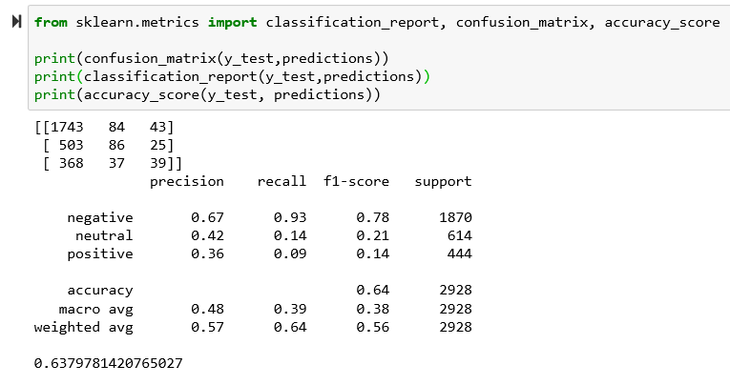
Case Study 2: Analyzing the Sentiment data, Implementing the model, Prediction, Confusion Matrix and Finding the accuracy of the data
13) Using classification metrics such as a confusion matrix, F1 measure, accuracy to evaluate the performance of the machine learning models
From the output, you can see that our algorithm achieved an accuracy of 63.79%. We performed an analysis of public tweets regarding six US airlines and achieved an accuracy of around 64%.

Slide 22
Recommendation
From the tweets visualization, we see that most of the airlines are effected by people complaining more on late flights and customer service issues which airlines need to work upon.
Ways to improve services:
1. Steps to prevent delay
Fly on point to point carriers, flying non-stop routes.
Scheduling flights in morning where time is not clashing with other airlines schedule.
2. To improve customer service
Improve quality of food served.
Hire good staff willing to work.
Ensure better communication.
Help families with children.

Slide 23
Conclusion
Twitter is a social media tool that many would like to express there view over use of any product or services, be it good or bad, sarcasm or serious topic discussion.
It is one of the best place to know how your product or services are being received by the consumers.
We can predict from the tweets the performance of your product or services and find different ways to improve and provide a overall customer satisfaction.

